Slide 1


Cloud Computing Deployment Models

Slide 2
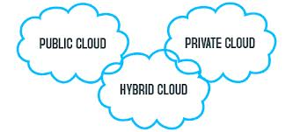
Types of Cloud Computing deployment models

Slide 3
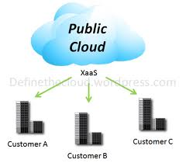
Public cloud
Public clouds are made available to the general public by a service provider who hosts the cloud infrastructure. Generally, public cloud providers like Amazon AWS, Microsoft and Google own and operate the infrastructure and offer access over the Internet.
With this model, customers have no visibility or control over where the infrastructure is located. It is important to note that all customers on public clouds share the same infrastructure pool with limited configuration, security protections and availability variances.

Slide 4
Public cloud
Benefits of public cloud
Pay as you go
Scalability
High availability
Easy Accessibility
No Maintenance Required
Automatic Updates

Slide 5
Public cloud
Disadvantages of public cloud
Lacks correct management
The consumer has no control of information or infrastructure.
There are problems with knowledge privacy and integrity
Performance
The performance of the network depends on speed of the web property

Slide 6
Public cloud
Disadvantages of public cloud
Weak security
Since hardware resources are shared among multiple users, security risks are more significant. Data may be vulnerable to unauthorized access, data breaches, or theft.
Customization
Customization of services or resources isn’t potential

Slide 7
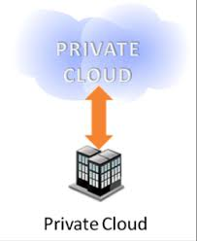
Private cloud
Private cloud is cloud infrastructure dedicated to a particular organization. Private clouds allow businesses to host applications in the cloud, while addressing concerns regarding data security and control, which is often lacking in a public cloud environment.
It is not shared with other organizations, whether managed internally or by a third-party, and it can be hosted internally or externally.

Slide 8
Private cloud
Benefits:
Higher privacy and security
More control
Improved reliability

Slide 9
Private cloud
Disadvantages
Cost
Costs are substantial in the case of building an on-premise private cloud.
The running cost would include personnel cost and periodic hardware upgrade costs.
In the case of outsourced private cloud, operating cost will include per resource usage and subject to change at the discretion of the service provider.

Slide 10
Private cloud
Disadvantages
Under-utilization
In some instances, the resources subscribed can be under-utilized.
Hence, optimizing the utilization of all resources is a challenge.

Slide 11
Private cloud
Disadvantages
Capacity ceiling
Due to physical hardware limitations with the service provider, there could be a capacity ceiling to handle only certain amount of servers or storage.

Slide 12
Private cloud
Disadvantages
Vendor lock-in
This can be a major impediment in private cloud adoption especially when the hardware and infrastructure is outsourced.
This is a service delivery technique where the client company is forced to continue with the same service provider, thus preventing the client to migrate to another vendor.

Slide 13
Hybrid cloud
Hybrid Clouds are a composition of two or more clouds (private, community or public) that remain unique entities but are bound together offering the advantages of multiple deployment models.
In a hybrid cloud, you can leverage third party cloud providers in either a full or partial manner; increasing the flexibility of computing. Augmenting a traditional private cloud with the resources of a public cloud can be used to manage any unexpected surges in workload.

Slide 14
Hybrid cloud
Benefits:
Risk management
Flexibility
Scalability
Enhanced security
Backup and disaster recovery
More opportunity for innovation

Slide 15
Hybrid cloud
Disadvantages:
Reliability
The reliableness of the services depends upon technological and money capability of the cloud service suppliers.
Implementation
The hybrid cloud infrastructure is as difficult to implement as much as it is to maintain.
For example, setting up a hybrid cloud infrastructure creates a strong demand for network capabilities, storage, and servers.
Implementation of all these is time-intensive and requires accuracy to stave off any inherent issue that may result after.

Slide 16
Hybrid cloud
Disadvantages:
Hardware expenses
With the hybrid cloud infrastructure, organizations must maintain and spend on on-premises hardware for handling the computing needs of the private cloud.
Although public cloud operations offset the hardware expenses ultimately, it still depends on organizations and their computing requirements.
Also, the cost accompanied with maintenance and installation of the hybrid cloud infrastructure is high.

Slide 17
Hybrid cloud
Disadvantages:
Security concern
The blend of public cloud, private cloud, and on-premises deployment makes the hybrid cloud infrastructure to be free of risks such as intrusion between neighboring environments.
However, there might be cases of misuse of the hybrid cloud infrastructure contracted by third-party vendors.
This puts the organizations at risk in terms of cyberattacks on the primary server, potentially creating the possibility of breaches to systems.

Slide 18
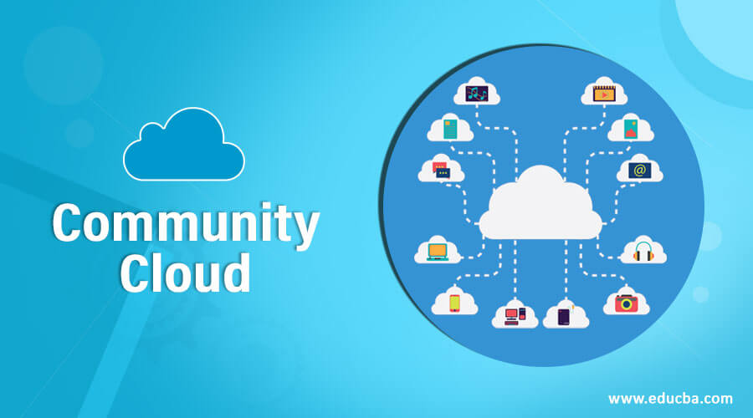
Community cloud
Community cloud is a cloud infrastructure that allows systems and services to be accessible by a group of several organizations to share the information.
A community cloud in computing could be a corporate effort within which the infrastructure is shared between many organizations from selected community with common considerations.

Slide 19
Community cloud
Benefits:
Cost-effectiveness:
The cost-effectiveness of setting up a community cloud vs. a private cloud is a compelling reason for organizations such as educational institutions to consider this shift.
A community cloud allows users to connect to the same environment, with their sessions segmented logically.
This removes the need to have separate servers to fulfill the same requirements across organizations.

Slide 20
Community cloud
Benefits:
Regulatory compliance:
By banding together under the community cloud umbrella, the common interpretation and implementation of laws can be ensured.
This drastically reduces vulnerability to legal action.
A community cloud allows users to connect to the same environment, with their sessions segmented logically.

Slide 21
Community cloud
Benefits:
Industry-based security requirements:
The expertise and technology to implement these security requirements cannot be avoided.
This is where community cloud members help each other by sharing expertise.

Slide 22
Community cloud
Benefits:
High availability:
The lure of cloud solutions lies in the fact that most come with high availability, meaning downtime is low or nonexistent.
This holds true for community clouds as well.

Slide 23
Community cloud
Disadvantages:
The Community cloud is not a good choice for every organization.
Slow adoption to data.
The fixed amount of data storage and bandwidth is shared among all community members.
Community Cloud is costly than the public cloud.
Sharing responsibilities among organizations is difficult.

